Slide 1

League of Frequencies
Riley Abrahamson
Matthew Martin

Slide 2


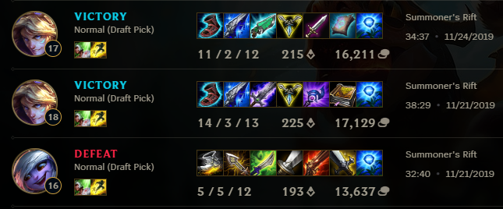




Project Overview

Slide 3

Tools
Riot API
Cassiopeia Library
Python
R
RStudio
U.GG

Slide 4

Data Collection

Slide 5
Generating Match Data
Run a loop to pick up match data
Push data into a MongoDB collection
Parse match data in Python to create transaction tables

Slide 6
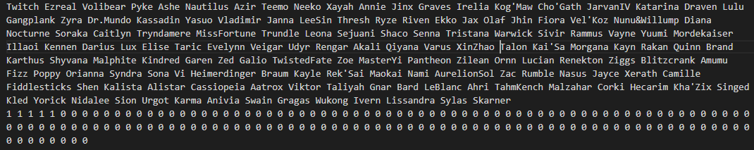
Example of Match Data

Slide 7

Data Mining

Slide 8
Techniques Used
Frequency
Classification
Apriori Frequency Mining in R
KNN Classifier Naïve Bayes Classifier
Both in Python

Slide 9
Results of Frequencies
Support = 0.01 or about 150 matches
Wins
Losses
There were no winning combinations of champions that had enough support
Graves, Kog'maw​
Kog'maw, Miss Fortune​
Graves, Miss Fortune​
Jinx, Graves​
Nautilus, Yasuo​
Yasuo, Master Yi​
Miss Fortune, Lux​
Caitlyn, Lux​
Yasuo, Lux​
Ashe, Miss Fortune​
Jinx, Yasuo​
Ashe, Yasuo​

Slide 10
Notes on Results
Senna is the most recent champion and therefore had a disproportionate amount of games​
Caused her to be in almost every win or loss combination​
Only listed those without her in them​
There were several champions that appeared in many of the frequent losing combinations (3+):​
Miss Fortune, Graves, Yasuo, Lux​

Slide 11
Results of Classification
Naive Bayesian Classification
Accuracy = 0.4783
Precision = 0.5000
Recall = 0.0035
KNN Classification
Accuracy = 0.4982​
Sensitivity = 0.5571​
Specificity = 0.4334​
Precision = 0.5177

Slide 12


Limitations & Challenges
We were severely limited by the number of data points and the dimensions of the data​
With how our data plots out, classification is tough since all the points are clustered so tightly together​
Most champions have around 50%-win rates, so we would need millions of matches to show significant results
40.17%
55.26%

Slide 13
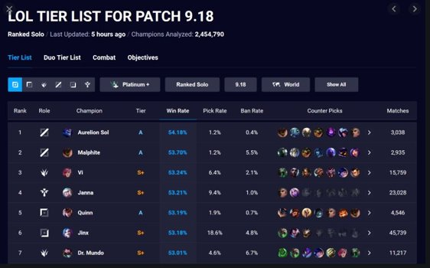
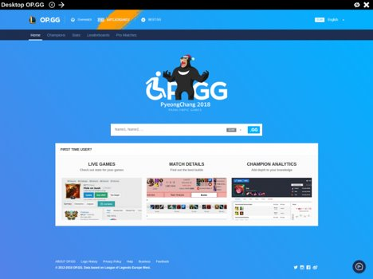
Examples
U.GG
OP.GG

Slide 14






Final Takeaways
Balance Issues
Match Prediction
Fraud/Botting Detection

